Slide 1
Design Solutions for Platform Services
Web Apps
API Apps
Mobile Apps
Push Notification

Slide 2
Platform Services
1. Design Web Applications
Design Azure App Service Web Apps, design custom web API, offload long-running applications using WebJobs, secure Web API using Azure AD, design Web Apps for scalability and performance, deploy Azure Web Apps to multiple regions for high availability, deploy Web Apps, create App Service plans, design Web Apps for business continuity, configure data replication patterns, update Azure Web Apps with minimal downtime, back up and restore data, design for disaster recovery
Design Mobile Applications
Design Azure Mobile Services; consume Mobile Apps from cross-platform clients; integrate offline sync capabilities into an application; extend Mobile Apps using custom code; implement Mobile Apps using Microsoft .NET or Node.js; secure Mobile Apps using Azure AD; implement push notification services in Mobile Apps; send push notifications to all subscribers, specific subscribers, or a segment of subscribers

Slide 3
There are many Azure products and features you need to be familiar with for the exam. In preparing for the exam, you should strive for at least an introductory level of understanding of Azure products that are not specifically called out in the exam skills. This will help you rule out choices when you see them on the exam.

Slide 4
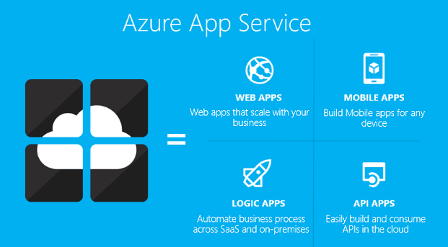
App Service
Authentication
Backup/Restore
Deployment
Networking
Scalability
WebJobs

Slide 5
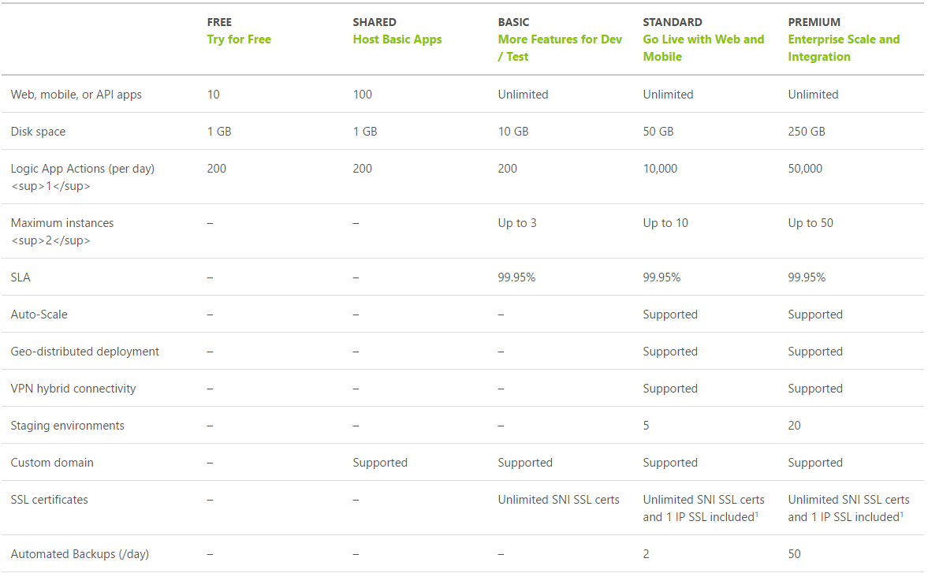
App Service Plan Tiers
https://azure.microsof.com/en-us/pricing/details/app-service/plans/

Slide 6
App Service Plan
Represents the collection of physical resources used to host your apps
Region (West US, East US, etc.)
Scale count (one, two, three instances, etc.)
Instance size (Small, Medium, Large)
SKU (Free, Shared, Basic, Standard, Premium)
Web Apps, Mobile Apps, API Apps, Functions run in an App Service Plan
Notes:
Create App Service Plans
Azure App Service plans in-depth overview
https://docs.microsoft.com/en-us/azure/app-service/azure-web-sites-web-hosting-plans-in-depth-overview?toc=%2fazure%2fapp-service-web%2ftoc.json

Slide 7
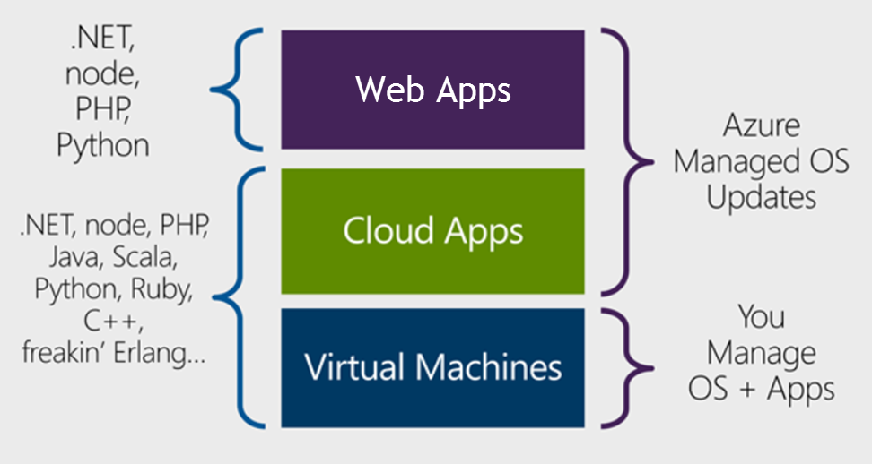
Design Azure App Service Web Apps
Notes:
Design Azure App Service Web Apps
Web Apps overview
https://docs.microsoft.com/en-us/azure/app-service-web/app-service-web-overview
https://docs.microsoft.com/en-us/azure/app-service-web/choose-web-site-cloud-service-vm#scenarios

Slide 8
Design Azure App Service Web Apps
Platform as a Service (PaaS)
Azure Resource Manager (ARM) Technology
Easy to use with existing development skills:
VSTS/Git/GitHub/etc. for deployment Visual Studio integration
Other Azure options for deploying web applications:
Virtual Machines (IaaS)
Service Fabric (Microservice architectures)
Cloud Services (Web Roles and Worker Roles) – Older ASM technology
Notes:
ASM = Azure Service Manager

Slide 9
Quite a few Azure services provide the same capability. You need to understand the features and common usages in order to pick the best choices on the exam.
Example:
Virtual machines and web apps can be used for websites however you cannot remote desktop to a web app machine.

Slide 10
Design Custom Web API
Web API is a one or more RESTful services (with one or more operations)
Endpoints expose services to external, partner or internal developers
Can implement in several technologies:
ASP.Net Web API
Node.js
App Service options:
Web App (if you need a web site too)
Mobile App
API App
Notes:
Design Custom Web API
Create a REST service using ASP.NET Web API and SQL Database in Azure App Service
https://docs.microsoft.com/en-us/azure/app-service-web/web-sites-dotnet-rest-service-aspnet-api-sql-database
https://azure.microsoft.com/en-us/services/api-management/

Slide 11
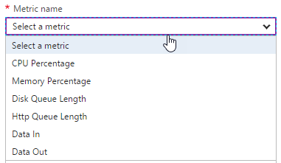
Design for Scalability and Performance
Scale Up – Change pricing tiers: Free, Shared, Basic, Standard, Premium
Scale Out – Change instance count: manually, auto
Scaling condition rules: Scheduled or Metric
Can have multiple condition rules
Can notify via email or webhook when autoscale events occur
Notes:
Design Web Apps for Scalability and Performance
Scale up an app in Azure
https://docs.microsoft.com/en-us/azure/app-service-web/web-sites-scale
Scale instance count manually or automatically
https://docs.microsoft.com/en-us/azure/monitoring-and-diagnostics/insights-how-to-scale?toc=%2fazure%2fapp-service-web%2ftoc.json

Slide 12
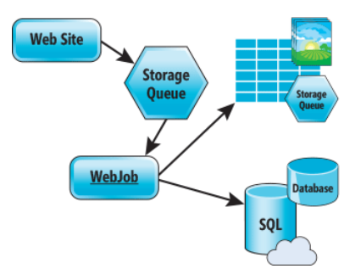
Design for Scalability and Performance
Design for Scale Out
Move towards stateless or at least distributed session/cache
Redis Cache for any Session/Cache needed
Move towards asynchronous UI
Queues for passing work off
Notes:
Azure Web Sites : Scaling Your Web Application with Azure Web Sites
https://msdn.microsoft.com/en-us/magazine/dn786914.aspx
Deploy Azure Web Apps to Multiple Regions for High Availability
Controlling Azure web app traffic with Azure Traffic Manager
https://docs.microsoft.com/en-us/azure/app-service-web/web-sites-traffic-manager
Add a Content Delivery Network (CDN) to an Azure App Service
https://docs.microsoft.com/en-us/azure/app-service-web/app-service-web-tutorial-content-delivery-network

Slide 13
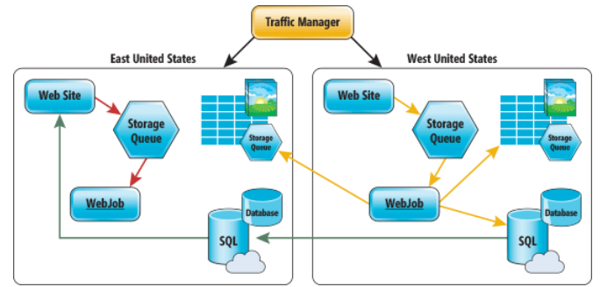
Deploy Azure Web Apps to Multiple Regions
Traffic Manager for routing traffic between regions
Performance – for directing user to closest region Failover – for secondary site Round Robin – for balancing traffic
CDN
Places static content close to user (images, media, etc)
Notes:
Deploy Azure Web Apps to Multiple Regions for High Availability
Controlling Azure web app traffic with Azure Traffic Manager
https://docs.microsoft.com/en-us/azure/app-service-web/web-sites-traffic-manager
Add a Content Delivery Network (CDN) to an Azure App Service
https://docs.microsoft.com/en-us/azure/app-service-web/app-service-web-tutorial-content-delivery-network
Best Practices: Windows Azure Websites (WAWS)
https://azure.microsoft.com/en-us/blog/best-practices-windows-azure-websites-waws/

Slide 14
Deploy
Web Deploy
Kudu (Git/Mercurial/OneDrive/Dropbox)
VSTS/Github/Bitbucket
Browser drag and drop (Chrome and Firefox)
FTP/FTPS
Filezilla, Windows Explorer
App Service infrastructure can be setup using PowerShell, Azure CLI or RM templates
Notes:
Deploy Web Apps
Deploy your app to Azure App Service
https://docs.microsoft.com/en-us/azure/app-service-web/web-sites-deploy

Slide 15
Update Web Apps with Minimal Downtime
Deployment Slots are live apps with their own hostnames
Only available for Standard or Premium App Service plans
Number of slots available depend on App Service Plan
App content and configurations can be swapped between two deployment slots
Not all settings and configurations are swapped
Some settings can be marked to not swap
Testing in Production feature allows you to spread traffic across multiple deployment slots
Notes:
Update Azure Web Apps with Minimal Downtime
Set up staging environments in Azure App Service
https://docs.microsoft.com/en-us/azure/app-service-web/web-sites-staged-publishing

Slide 16
What gets Swapped with a Deployment Slot?
Swapped | Not Swapped
App Settings – can be configured to not swap | Custom Domain Names
Connection Strings – can be configured to not swap | SSL certificates and bindings
General settings | Scale settings (only production slots are scalable)
Handler mappings | Publishing endpoints
Diagnostic logs settings

Slide 17
Design Web Apps for Business Continuity
Web/Mobile/API Apps
Multiple instances (single data center)
Multiple data centers with Traffic Manager to balance traffic
Backup/Restore
Notes:
Design Web Apps for Business Continuity
**Restore from Azure Backup Vault - SQL DB has to be set for long term retention
Built in HA for App Service, SQL Database and Storage
Business Continuity (BC) is defined as the capability of the organization to continue delivery of products or services at acceptable predefined levels following a disruptive incident. ( Source: ISO 22301:2012)
Controlling Azure web app traffic with Azure Traffic Manager
https://docs.microsoft.com/en-us/azure/app-service-web/web-sites-traffic-manager
Overview of business continuity with Azure SQL Database
https://docs.microsoft.com/en-us/azure/sql-database/sql-database-business-continuity
Designing resilient applications for Azure
https://docs.microsoft.com/en-us/azure/architecture/resiliency/

Slide 18
Configure Data Replication Patterns
Features Available
Blob storage: geo-redundant and read-access geo-redundant storage
SQL Database: geo-restore, geo-replicate
CosmosDB/DocumentDB: global replication
Custom Code
Can write WebJob to copy data to other regions or on-premise
Notes:
Configure Data Replication Patterns
Data Replication and Synchronization Guidance
https://msdn.microsoft.com/en-us/library/dn589787.aspx
Azure Storage replication
https://docs.microsoft.com/en-us/azure/storage/storage-redundancy

Slide 19
Many Azure services are highly available (HA) by design – such as SQL Database, App Service, Azure Storage and CosmosDB. Others require you to use specific pricing tiers in order to get HA – such as Virtual Machines, Redis Cache and Search. Before taking the exam, you should look through the Service Level Agreements and learn what it takes to get HA for each product that is on the exam.
https://azure.microsoft.com/en-us/support/legal/sla/

Slide 20
Deploy a Web App
Notes:
The main tasks for this exercise are as follows:
Create virtual networks by using Azure Portal
Task 1: Create a virtual network by using the Azure portal
From MIA-CL1, start Microsoft Edge, go to http://portal.azure.com, and then, if prompted, sign in to the Azure portal as the Service Administrator of your Azure subscription.
From the Azure portal, create a new virtual network by using the following settings:
Name: labVNet1
Address space: 10.0.0.0/16
Subnet name: Subnet1
Subnet address range: 10.0.0.0/24
Subscription: Your Azure subscription
Resource group: Create new
New resource group name: 10979D05-LabRG01
Location: Azure data center where you can deploy Azure VMs, closest to the location of your classroom
Pin to dashboard: Select the checkbox
From the Azure portal, create a new virtual network by using the following settings:
Name: labVNet2
Address space: 10.1.0.0/16
Subnet name: Subnet1
Subnet address range: 10.1.0.0/24
Subscription: Your Azure subscription
Resource group: Use existing 10979D05-LabRG01
Location: Azure data center where you can deploy Azure VMs, closest to the location of your classroom
Pin to dashboard: Select the checkbox
Task 2: Configure VNet peering by using the Azure portal
In the Azure portal, navigate to the labVNet1 blade.
From the labVNet1 blade, create a VNet peering with the following settings:
Name: labVNet1-labVNet2
Deployment model: Resource manager
Subscription: Your Azure subscription
Virtual network: labVNet2
Allow virtual network access: Enabled.
Allow forwarded traffic: Disabled
Allow gateway transit: Disabled
Use remote gateways: Disabled
In the Azure portal, navigate to the labVNet2 blade.
From the labVNet2 blade, create a VNet peering with the following settings:
Name: labVNet2-labVNet1
Deployment model: Resource manager
Subscription: Your Azure subscription
Virtual network: labVNet1
Allow virtual network access: Enabled.
Allow forwarded traffic: Disabled
Allow gateway transit: Disabled
Use remote gateways: Disabled

Slide 21
App Service Backup
Configure a storage account and container to store backup
Can store backup in another region
Configure schedule for backup to occur
Can optionally backup database also (as a bacpac file)
Exclude files with a _backup.filter file listing paths to exclude
Limit of 10GB of content for a backup (site files + bacpac)
Stores backup as .zip
Notes:
Back up and Restore Data
** For a database to appear in this list, its connection string must exist in the Connection strings section of the Application settings blade for your app.
Back up your app in Azure
https://docs.microsoft.com/en-us/azure/app-service-web/web-sites-backup
Restore an app in Azure
https://docs.microsoft.com/en-us/azure/app-service-web/web-sites-restore

Slide 22
App Service Restore
Restore options:
Replace existing app (backup was taken from)
Replace another app or create another app based on backup
Notes:
Back up and Restore Data
Restore an app in Azure
https://docs.microsoft.com/en-us/azure/app-service-web/web-sites-restore

Slide 23
Design for Disaster Recovery
Backup/Restore - is about data or workloads and getting them back to a known state and running.
Disaster Recovery - is about getting your systems up and running in another location.
Recovery time objective (RTO) – maximum acceptable time before the application fully recovers after the disruption.
Recovery point objective (RPO) – maximum amount of recent data updates (time interval) the application can tolerate losing.

Slide 24
Take a look at the Azure PowerShell cmdlets and the CLI documentation. The exam will have questions that use either PowerShell or CLI commands.
Just because this is a design level exam, does not mean there won’t be any code level questions.

Slide 25
Extend Mobile Apps using Custom Code
Mobile Client SDKs available for:
Android
Apache Cordova
iOS
Windows
Xamarin.Android
Xamarin.Forms
Xamarin.iOS
Notes:
Extend Mobile Apps using Custom Code
Android
https://docs.microsoft.com/en-us/azure/app-service-mobile/app-service-mobile-android-how-to-use-client-library
Cordova
https://docs.microsoft.com/en-us/azure/app-service-mobile/app-service-mobile-cordova-how-to-use-client-library
iOS
https://docs.microsoft.com/en-us/azure/app-service-mobile/app-service-mobile-ios-how-to-use-client-library

Slide 26
Implement Mobile Apps Using Microsoft .NET or node.js
Mobile App server SDKs available for:
.NET
Node.js (has Easy Tables and Easy APIs available in portal)
SDKs provide:
Table operations for data access
Custom API operations
Push Notifications
Integration with Authentication
Notes:
Implement Mobile Apps Using Microsoft .NET or node.js
.NET
https://docs.microsoft.com/en-us/azure/app-service-mobile/app-service-mobile-dotnet-backend-how-to-use-server-sdk
Node.js
https://docs.microsoft.com/en-us/azure/app-service-mobile/app-service-mobile-node-backend-how-to-use-server-sdk

Slide 27
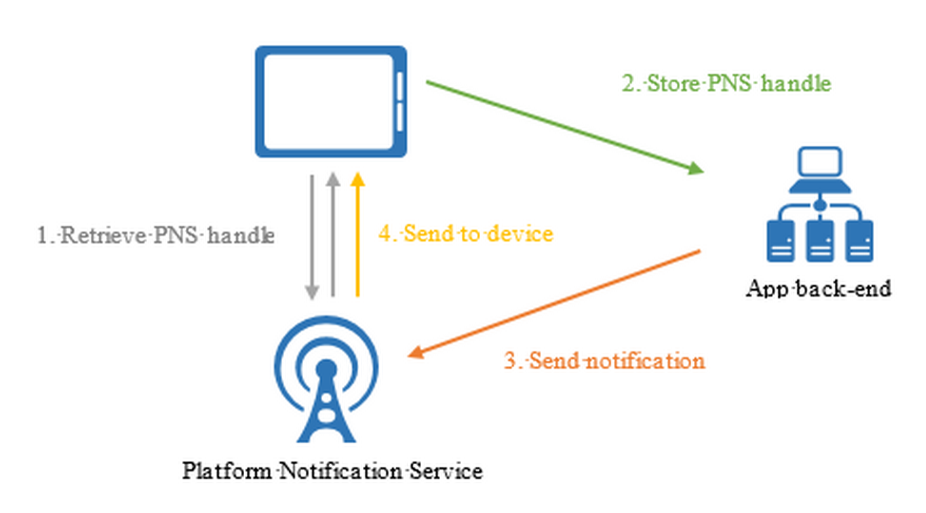
Implement Push Notification Services in Mobile Apps
Abstracts the choreography to support push notification to mobile clients
Apple Push Notifications (APNS)
Google Cloud Messaging (GCM)
Windows (WNS)
Windows Phone (MPNS)
Amazon (ADM)
Notes:
Implement Push Notification Services in Mobile Apps
Add push notifications to your Windows app
https://docs.microsoft.com/en-us/azure/app-service-mobile/app-service-mobile-windows-store-dotnet-get-started-push

Slide 28
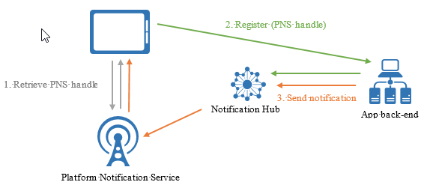
Send Push Notifications
Push on the App Service menu - Uses Notification Hubs
Broadcast to one or multiple platforms
Push to device or user
Push to segment with dynamic tags
Localized push
Silent push
Scheduled push
Direct push
Personalized push
Notes:
Send Push Notifications to All Subscribers
Send Push Notifications to Specific Subscribers
Send Push Notifications to a Segment of Subscribers
Azure Notification Hubs
https://docs.microsoft.com/en-us/azure/notification-hubs/notification-hubs-push-notification-overview

Slide 29
Mobile Apps are part of App Service, so the Authentication, Networking, Scaling, WebJobs, etc. are also available for Mobile Apps too.

